Slide 1
Project on ddos attack (week 6)
KAZA VENKATA SAI MADHAV
KAZA2V@CMICH.EDU

Slide 2
OVERVIEW
Week 1: Training of DDOS data set.
Week 2: Analysis of DDOS data set.
Week 3: Finding best supervised ML algorithm for DDOS detection.
Week 4: Using Naïve Bayes algorithm.
Week 5: Detection time and accuracy results for ML algorithm.
Week 6: Client puzzles and bitcoins generation algorithm for further research

Slide 3

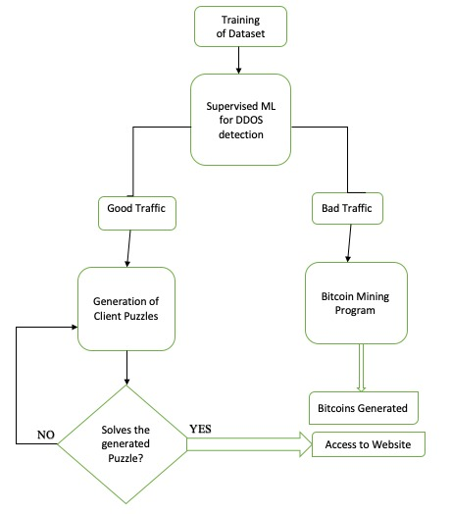
RESEARCH OVERVIEW

Slide 4
WEEK 1&2: TRAINING AND ANALYSIS OF DDOS DATASET
Shape of the dataset is found.
Every column name is printed.
Labelled dataset is split into normal and attack data.
Attacker source IP with their frequency is found.
Attacker source IP’s is converted to int format using socket and struct libraries in python (Jupyter notebook).

Slide 5

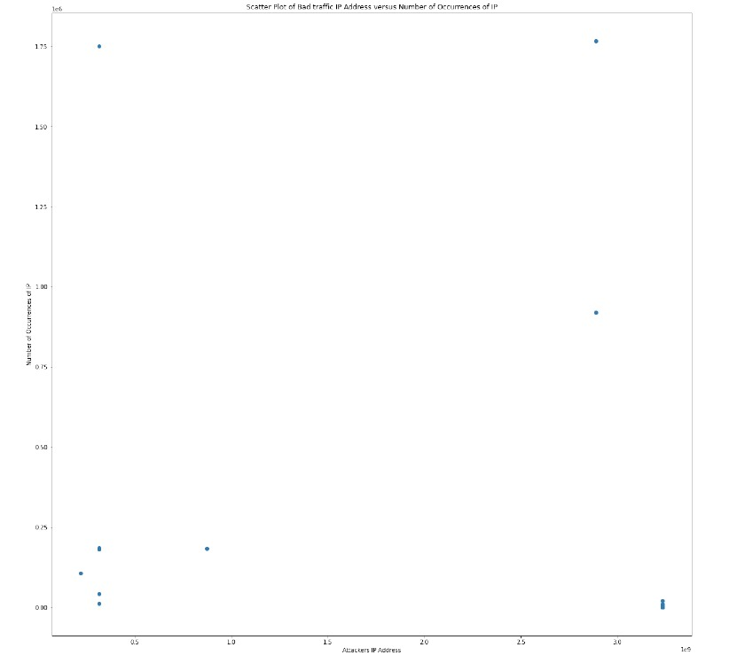
WEEK 1&2 (CONT…)
A figure is plotted with X-axis attackers IP address and Y-axis number of occurrences.

Slide 6
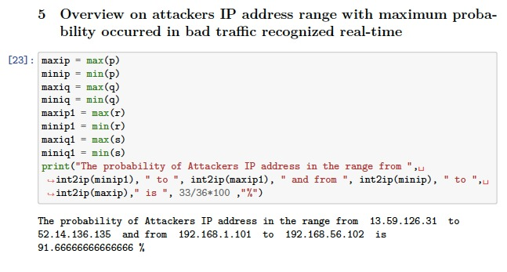
WEEK 1&2 (CONT…)
Overview of attackers’ source IP’s with maximum probability is shown in the figure.

Slide 7
WEEK 3: FINDING BEST ML ALGORITHM
Decision tree
K-nearest neighbor
Naïve bayes
Random forest

Slide 8
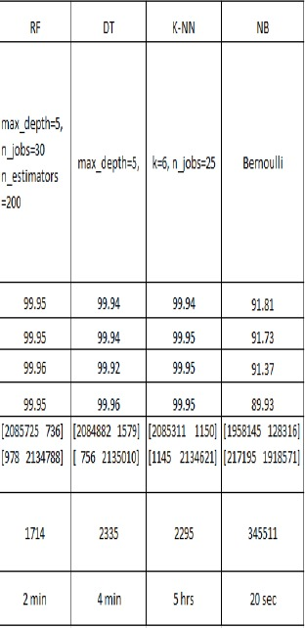
WEEK 3 (CONT…)
As mentioned in the paper “Machine learning DDoS detection using stochastic gradient boosting” , the accuracy and execution time can be seen in the picture.
Execution time and accuracy is selected optimally for naïve bayes ML algorithm.

Slide 9
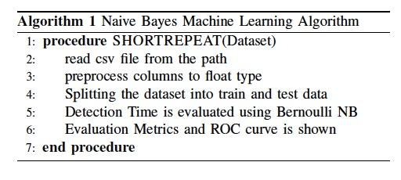
WEEK 4: NAÏVE BAYES ALGORITHM
As shown in the figure, Naïve bayes algorithm is implemented.
Evaluation metrics such as detection time and accuracy is found.
ROC curve is found with true positive rate and false positive rate.

Slide 10
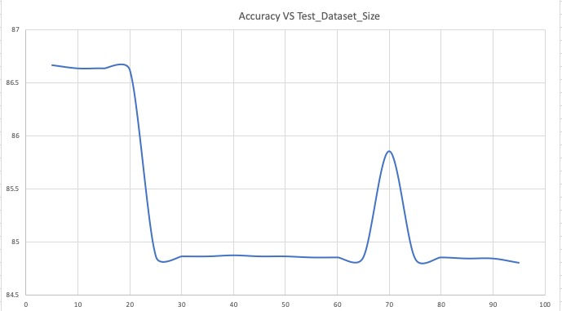
WEEK 5: ACCURACY

Slide 11
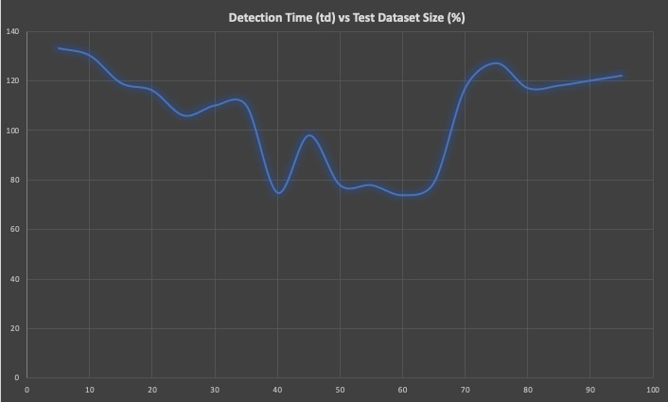
WEEK 5: DETECTION TIME

Slide 12
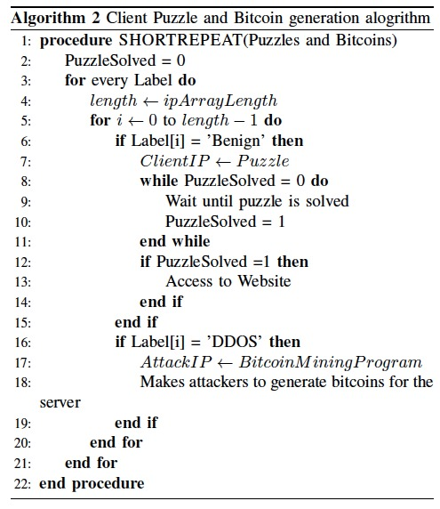
WEEK 6: CLIENT PUZZLES AND BIT COIN GENERATION

Slide 13
Q/A

Slide 14
THANK YOU FOR YOUR TIME.

